Slide 1

IST 261 (Fall 2019)
Application Development Design Studio I
UML
Phil O'Connell
pxo4@psu.edu

Slide 2
Unified Modeling Language
Visualize classes and their relationships
Helps when designing new software
Helps to understand existing software
The syntax is meant to apply to all languages
It's slightly different than Java
This presentation covers only some of UML

Slide 3
Access-Level Symbols
Each access level has a symbol
Symbol | Meaning
- | Private
# | Protected
~ | Package
+ | Public
Also called "default" access level

Slide 4
Inheritance: An Arrow (closed-head)
Class Person {
private String name = "";
private String ssn= "";
public String getName() {
return name;
}
public void setName(String name) {
this.name = name;
}
public String getSsn() {
return ssn;
}
public void setSsn(String ssn) {
this.ssn = ssn;
}
}
Person
This is important to know, but won't have any inheritance in today's lab.
- name : String - ssn : String
+ getName() : String
+ setName(name : String) : void
+ getSsn() : String
+ setSsn(ssn : String) : void
Give names to the parameters, for clarity
Points to the parent class
class Student extends Person {
private String major = "";
public String getMajor() {
return major;
}
public void setMajor(String major) {
this.major = major;
}
}
Student
- major : String
+ getMajor() : String
+ setMajor(major : String) : void

Slide 5
Lists: [0..*]
Class Game {
private String homeTeam;
private String visitingTeam;
private List<Inning> innings = new ArrayList<>();
getHomeTeam() {
return homeTeam;
}
getVisitingteam() {
return visitingTeam;
}
getInnints() {
return innings;
}
}
To designate any type of array (List, ArrayList, or standard array), use bracket notation
Game
- homeTeam : String - visitingTeam: String
- innings : Inning[0..*]
+ getHomeTeam() : String
+ getVisitingTeam() : String
+ getInnings() : Inning[0..*]

Slide 6
Constructor: Has No Return Type
Class Game {
private String homeTeam;
private String visitingTeam;
private List<Inning> innings = new ArrayList<>();
public Game(String home, String visitor) {
homeTeam = home;
visitingTeam = visitor;
}
getHomeTeam() {
return homeTeam;
}
getVisitingteam() {
return visitingTeam;
}
getInnints() {
return innings;
}
}
Constructors do not have return types
Game
- homeTeam : String - visitingTeam: String
- innings : Inning[0..*]
+ Game(String home, String visitor)
+ getHomeTeam() : String
+ getVisitingTeam() : String
+ getInnings() : Inning[0..*]

Slide 7
Enumerates
public enum ShirtSize{
SMALL,
MEDIUM,
LARGE,
EXTRA_LARGE
}
Literally put <<enumeration>> above the name
<<enumeration>>
ShirtSize
- homeTeam : String - visitingTeam: String
- innings : Inning[0..*]
+ Game(String home, String visitor)
+ getHomeTeam() : String
+ getVisitingTeam() : String
+ getInnings() : Inning[0..*]

Slide 8
Associations: Lines Having Cardinality
This is the class name
FlightPlan
A plane can be associated with 0 or many flight plans
+ flightNumber : int
+ departTime : Date
+ durationMinutes : int
Numbers indicating "how many"
+ delayFlight(min : int)
+ getArrival() : Date
0..*
0..1
A flight plan can be associated with 0 or 1 plane.
Plane
+ id : int
+ capacity : int
In reality (and in today's lab), we'd have private fields with getter/setters.
But I need room on the slide

Slide 9
Number/Symbols to Denote Associations
Symbol | Meaning
0..1 | Zero or one
1 | One only
0..* | Zero or more
* | Zero or more
1..* | One or more
3 | Three only
5..12 | Five to Twelve
Mean the same thing

Slide 10
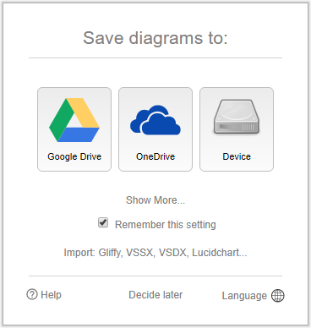
draw.io
In your web browser, go to http://draw.io

Slide 11
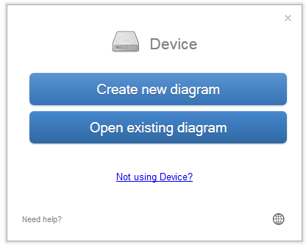
draw.io

Slide 12
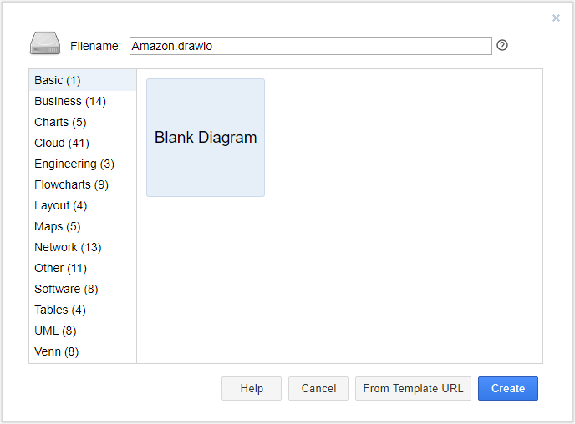
draw.io
Start with a Blank Diagram
Name the file Amazon.drawio

Slide 13
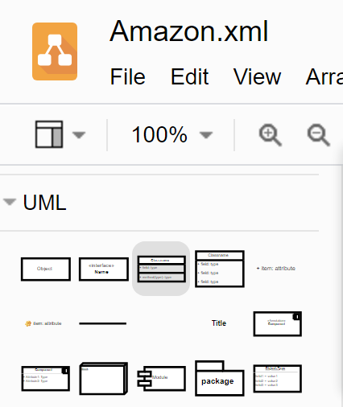
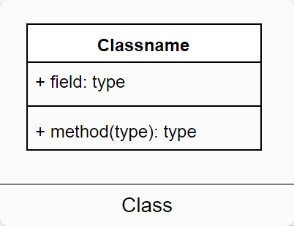
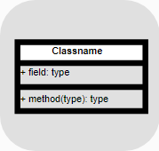
Choose UML Tool
Choose UML from left nav
Choose the Class image
Drag/drop to the canvas
Use to do the lab

Slide 14
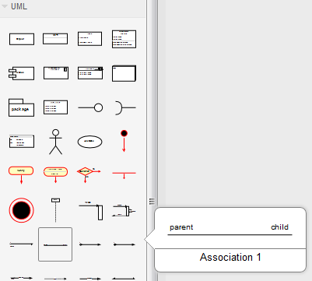
Associations in draw.io
For our exercise, use the parent-child connector
Drag/drop to the canvas
Edit "parent" and "child" to whatever cardinality you need

Slide 15
Lab
Use draw.io to create a UML for Amazon
Consider these components of the site
A shopper can have zero or more orders
An order can have 1 or more items
shopper account
id
name
items for sale
id
description
price
orders
order id
shopper id
These are not field or method names
e.g., the class is not "shopper account"
You need to come up with those for the UML

Slide 16
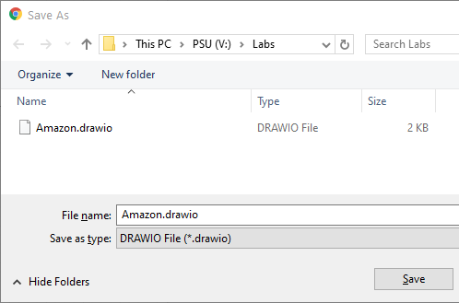
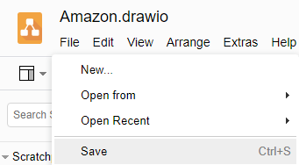
Save the File
Save Amazon.drawio to your V: drive or desktop
Submit for the lab

Slide 17
Lucidchart
Microsoft Teams includes Lucidchart
It's virtually the same interface as draw.io
In the following steps, we create a diagram named UML

Slide 18
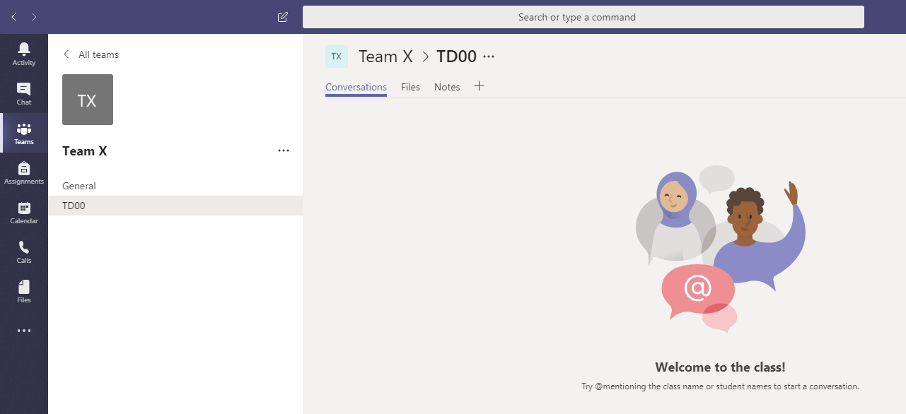
Add Lucidchart to the Channel

Slide 19
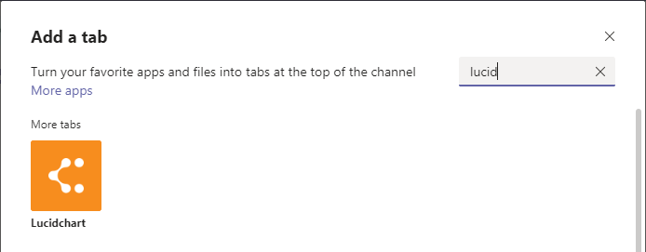
Add Lucidchart to the Channel
Find it by searching for lucid

Slide 20
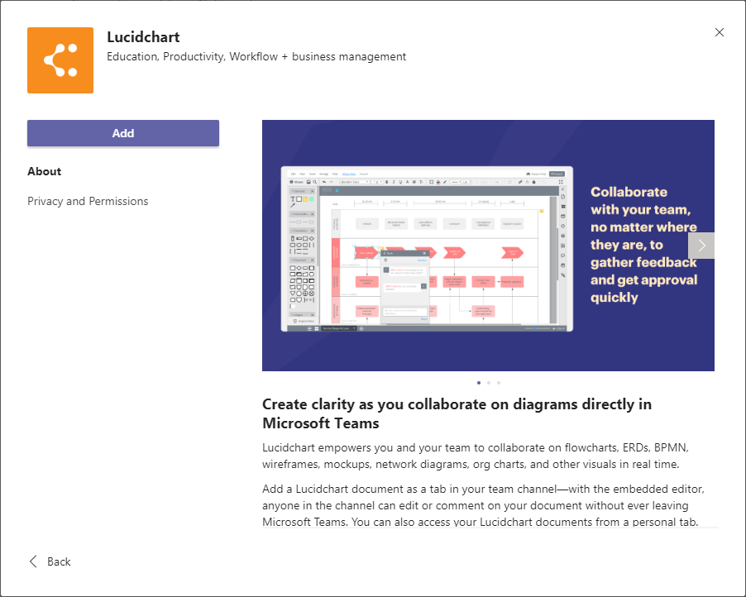
Add Lucidchart to the Channel

Slide 21
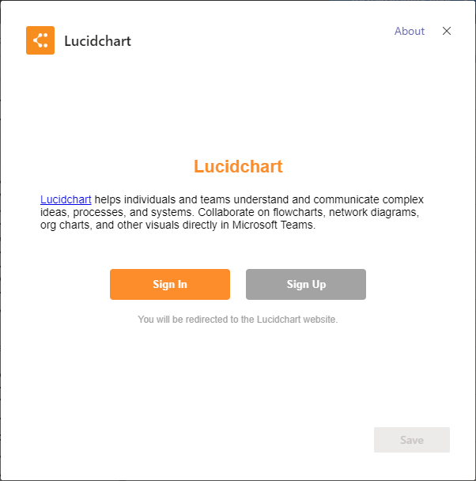
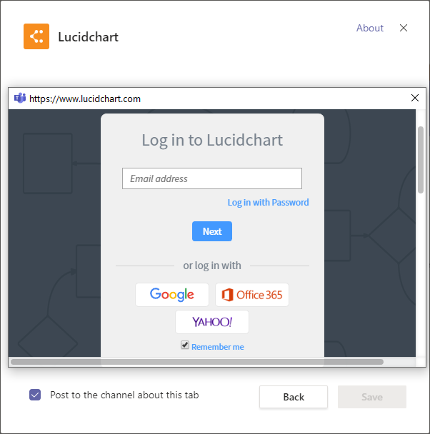
Sign In via Office 365

Slide 22
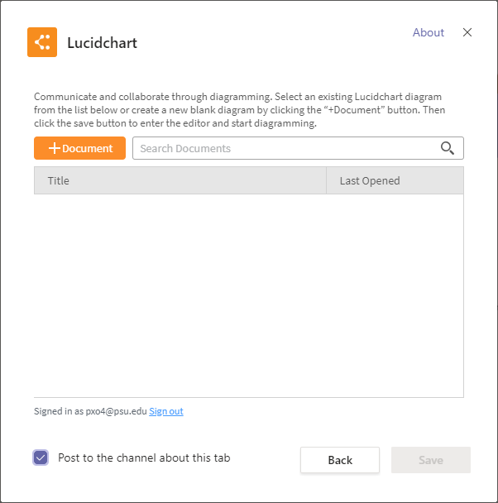
Click +Document

Slide 23
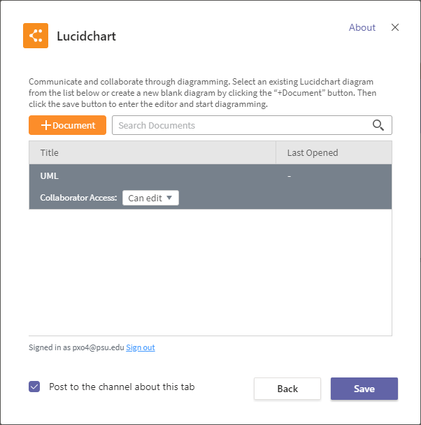
Create a Diagram Name UML

Slide 24
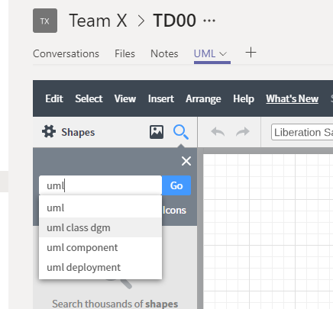
Find the "UML" Shapes

Slide 25
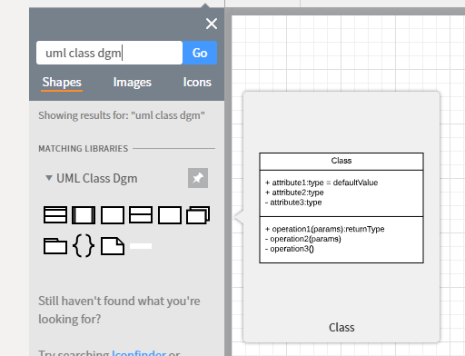
Find the "Class" Shape
Drag the Class shape onto the canvas

Slide 26
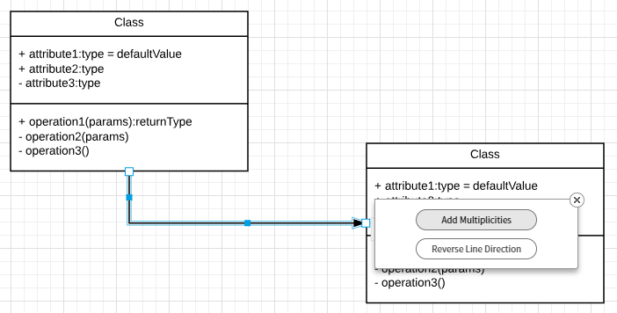

Connect Two Shapes
Add Multiplicities for the association connector
The cardinality will appear

Slide 27
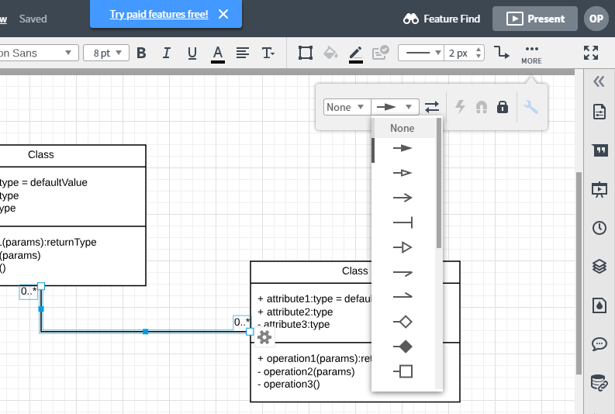
Remove the Arrow Head

